Slide 1
National Voter
Registration Day
Promoting Your Event

Slide 2


Thank you featured sponsors

Slide 3
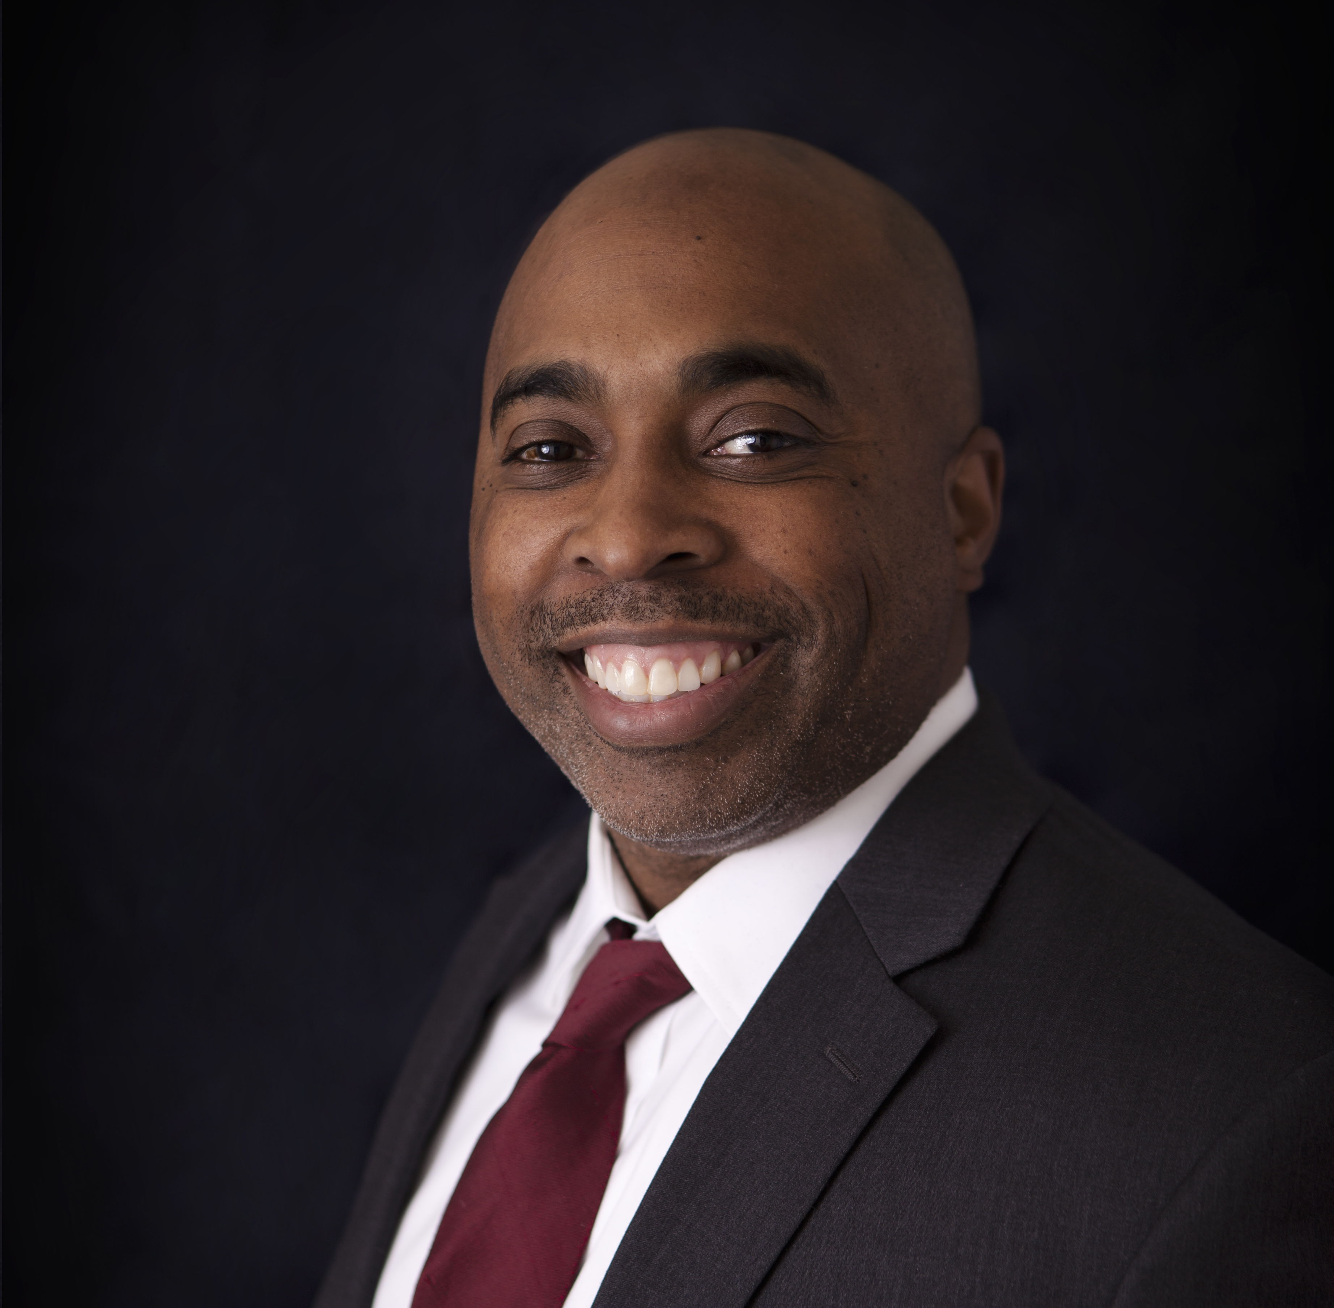
Agenda
Welcome
Background
  2019 goals
  National Voter Registration Day promotion in 2018
#VoteReady
Promotion Countdown
  Using the Communications toolkit to promote your event 4, 3, 2, 1 weeks out
Using the Events tools
Q&A
James Hill
Associate Director of Communications and Partnerships
National Voter Registration Day

Slide 4
QUESTION & ANSWER
Use the chat box to send questions

Slide 5
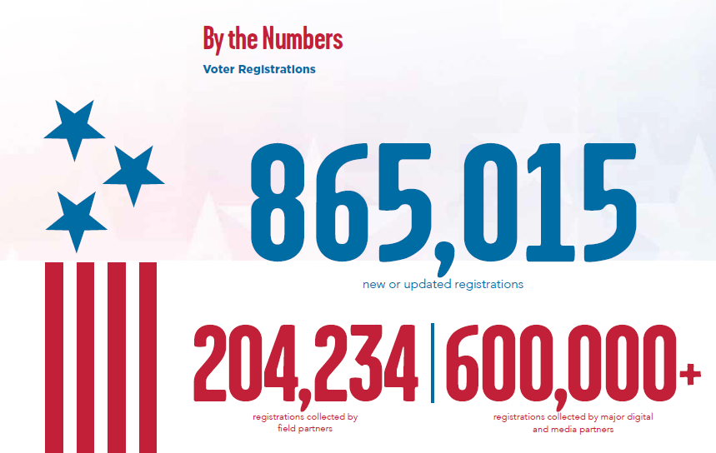

Slide 6
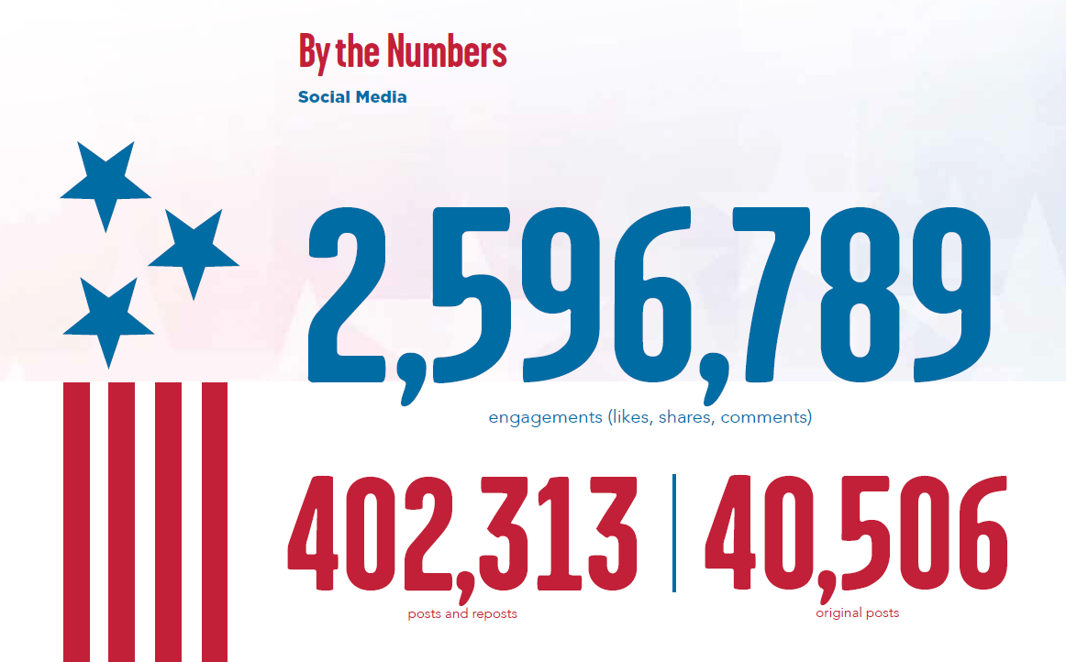

Slide 7
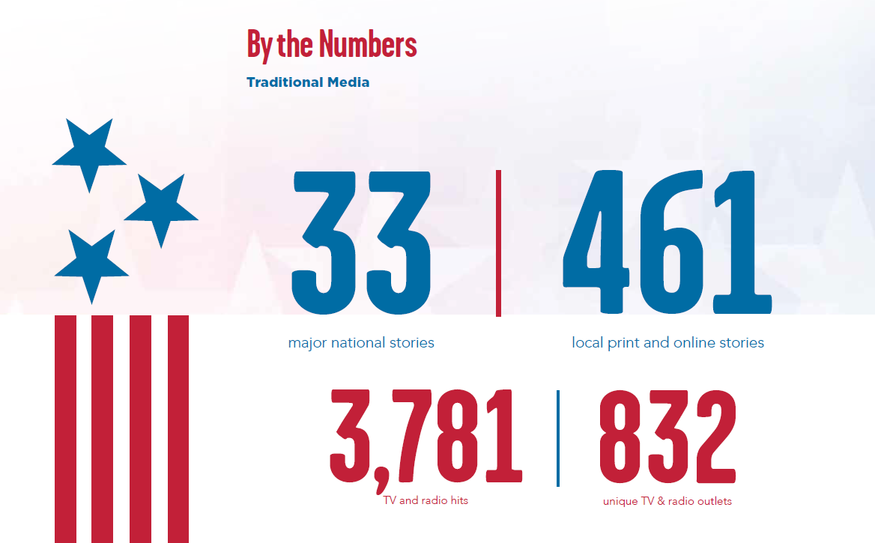

Slide 8
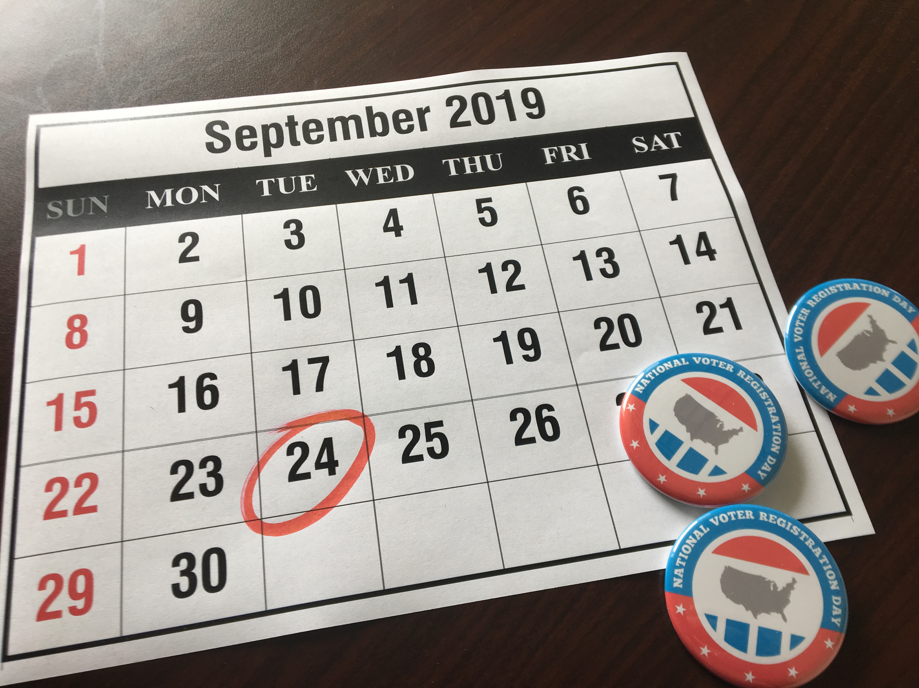
Goals for 2019
3,500 community partners
45 premier partners
200,000 new or updated voter registrations
100,000 social media posts and reposts
750,000 social media engagements
1,000 news stories

Slide 9
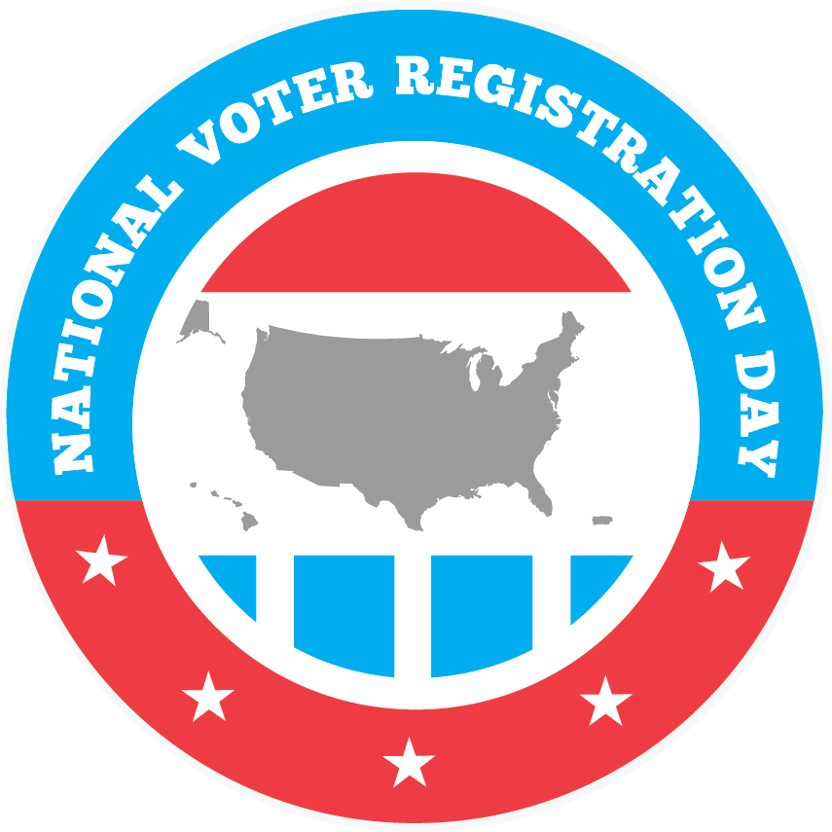
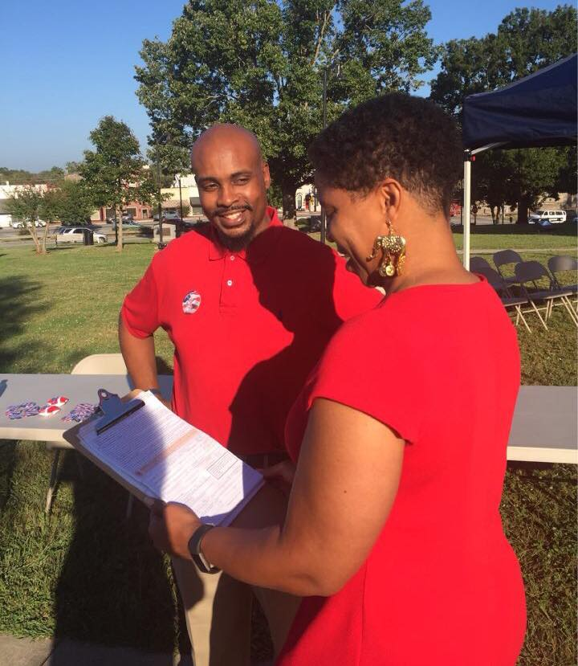
Using Communications Channels and Messaging
Leading up to September 24

Slide 10
Messaging for 2019
Use the 2019 Communications Toolkit for assets and inspiration to promote your participation, event, and registering to vote!
#NationalVoterRegistrationDay
#VoteReady
Use the official hashtag –#NationalVoterRegistrationDay – across your social media accounts. Yes, we know it’s long!
Tweets and Instagram photos with #NationalVoterRegistrationDay will appear on www.NationalVoterRegistrationDay.org in one of two feeds.
Keep posts nonpartisan and pro-democracy please.
It’s up to us to make sure eligible citizens are “vote ready.” This means:
  Being registered to vote – whether a new registration or updating an existing one –
  Knowing where your polling place is, what issues are on the ballot, and understanding candidate positions
Be sure to ask the question: “Are You #VoteReady?” in your promotions and to the voters you register on September 24th

Slide 11
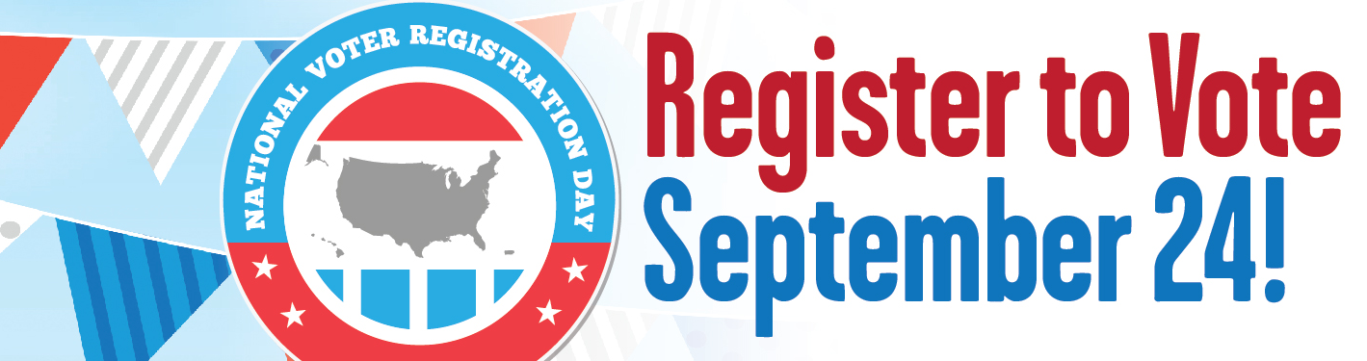
Our Communications Channels
Our handle across platforms is @natlvoterregday
https://www.facebook.com/natlvoterregday
https://www.instagram.com/natlvoterregday/
https://twitter.com/natlvoterregday
www.nationalvoterregistrationday.org

Slide 12
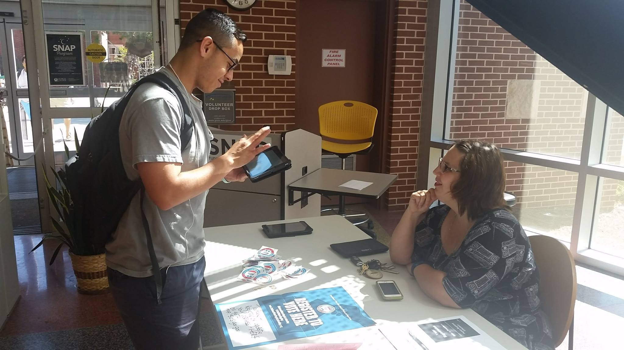
Promotion Countdown

Slide 13
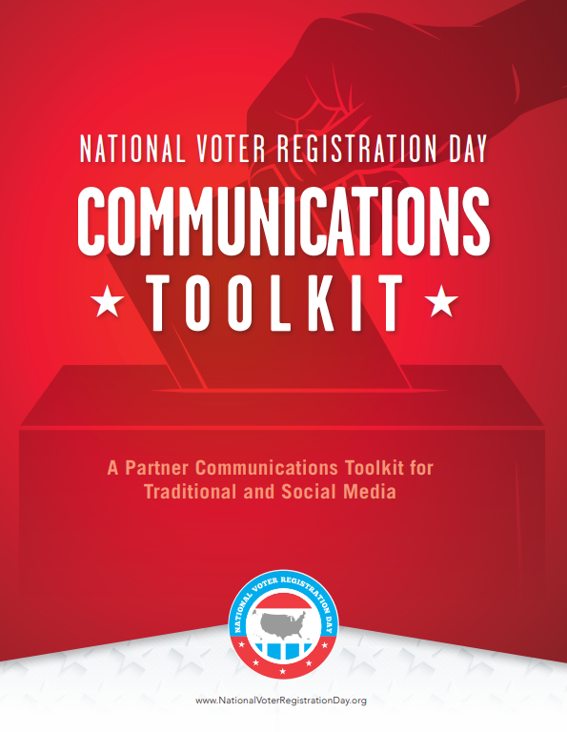
Four Weeks Out – August 27, 2019
ANNOUNCE PARTICIPATION
Send an email to your membership lists announcing your participation
Promote your participation with a press release and social media promotion.
  A sample press release and social media posts can be found in the “Resources” section of this packet.
Utilizing the #NationalVoterRegistrationDay hashtag, reach out to influencers and invite them to participate using the hashtag on September 24.
  Use the “influencer ask letter”

Slide 14
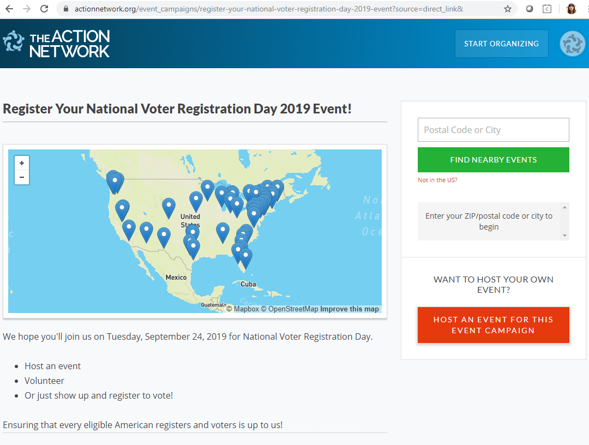
Three Weeks Out – Sept 3rd, 2019
PROMOTE YOUR EVENT
Create a National Voter Registration Day event on the our event tool, then promote the link through your organization’s communications channels.
Put up your posters around your building, campus, town, etc.

Slide 15
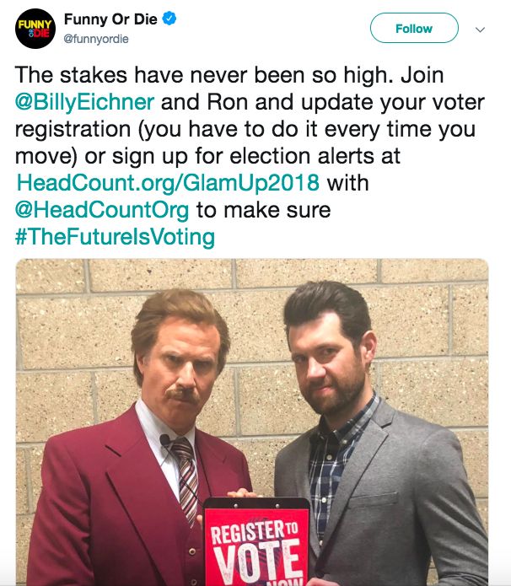
Two Weeks Out – Sept 10th, 2019
PROMOTE YOUR EVENT & REGISTERING TO VOTE
Increase frequency and the sense of urgency around upcoming National Voter Registration Day events.
Remind your membership lists by sending another email about events you are hosting.
  This is a good time for you to recruit volunteers and make sure everyone knows all the specifics about your activities.
  A sample email is provided in the “Resources” section of the toolkit
Keep your followers informed of upcoming events through social media
  Follow up with influencers. Remind them that the event is just two weeks away, and ensure the date is on their social media calendars for September 24.

Slide 16
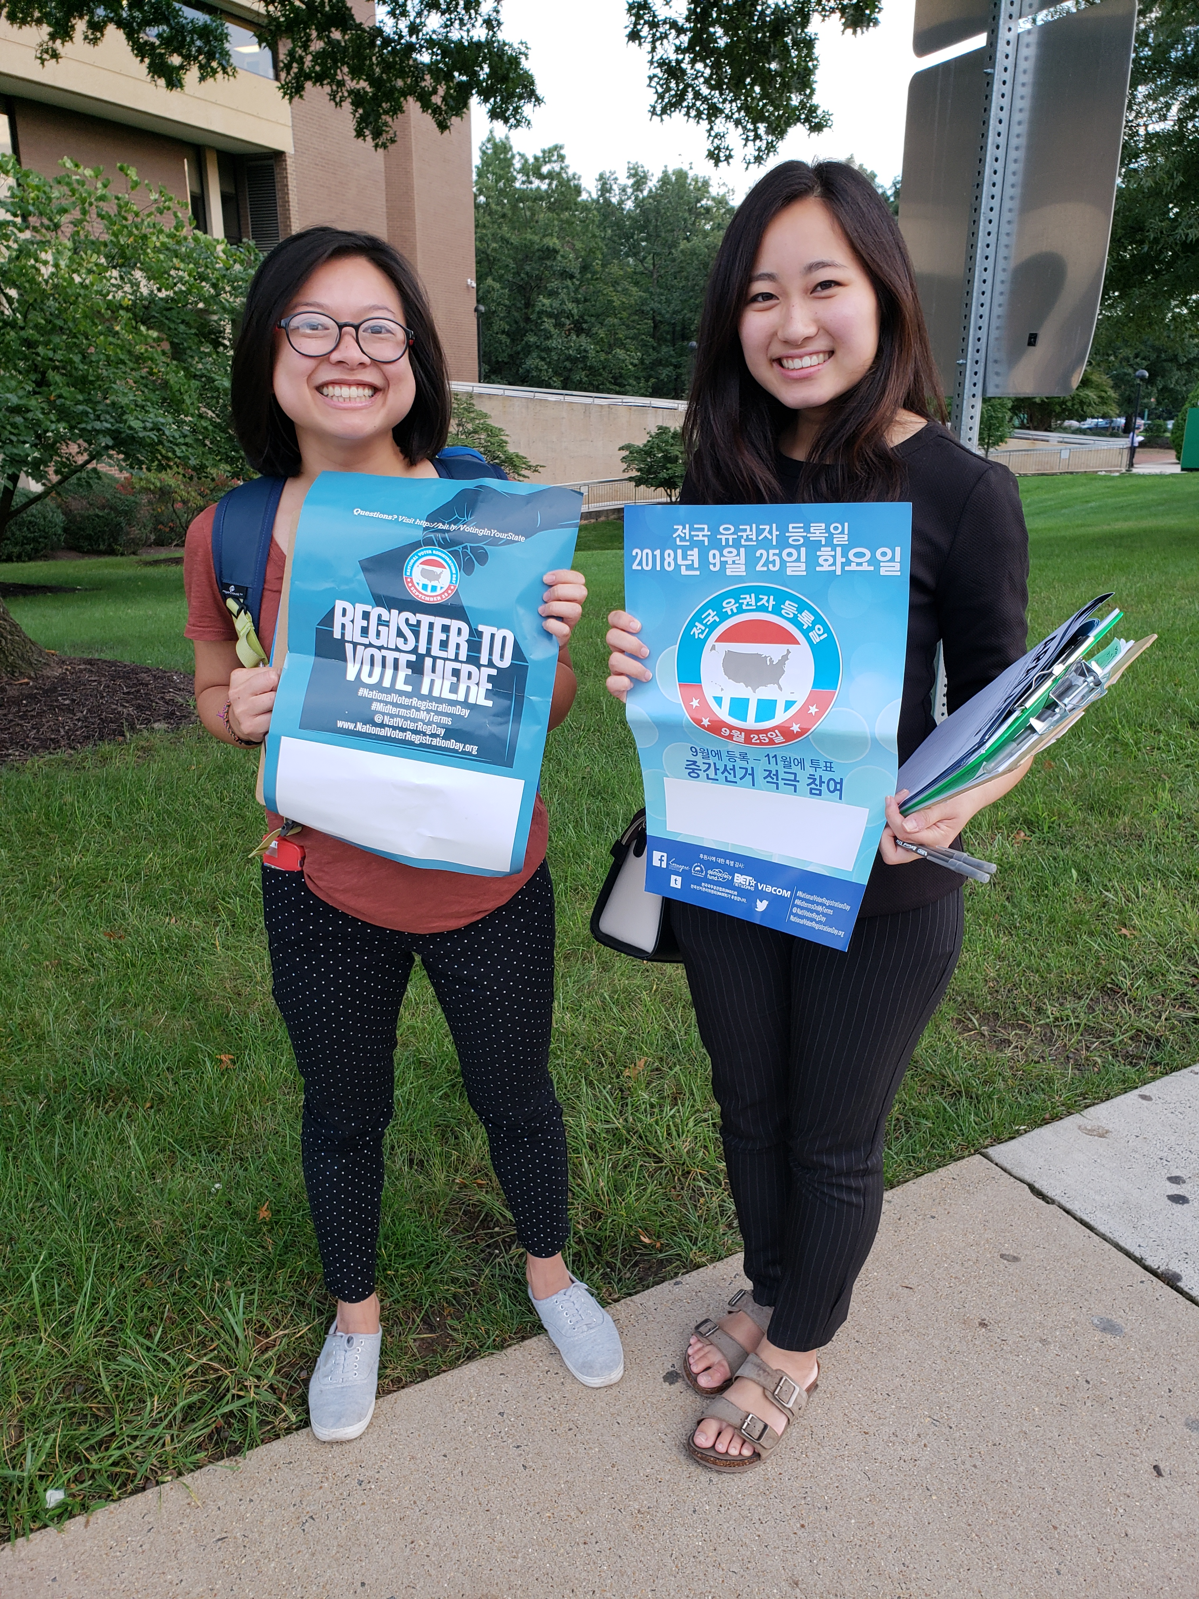
One Week Out – Sept 17th, 2019
FINAL PUSH!
Alert the media again by sending another press release or media alert. Make sure they have the details they need.
Increase social media posts with frequent, daily postings to social media and repeated calls to register to vote.
  Review our sample social media posts for ideas of how you can keep your followers engaged on Facebook and Twitter.
  Remember to promote your specific events and voter registration in general.

Slide 17
Day of National Voter Registration Day
September 24th, 2019
BEFORE Your Event
AFTER Your Event
Let’s make #NationalVoterRegistrationDay trend again this year! Use our sample posts to keep messaging consistent
Invite your membership lists to your event or to register online
Send out a final media alert to ensure that your event is getting the coverage it needs
Know your stuff. Review the talking points included in the communications toolkit so you can answer media questions
Take the Post-Event survey and tell us about your event
Post photos to social media, give shoutouts to partners, volunteers, and voters
Write about your event in your next newsletter

Slide 18
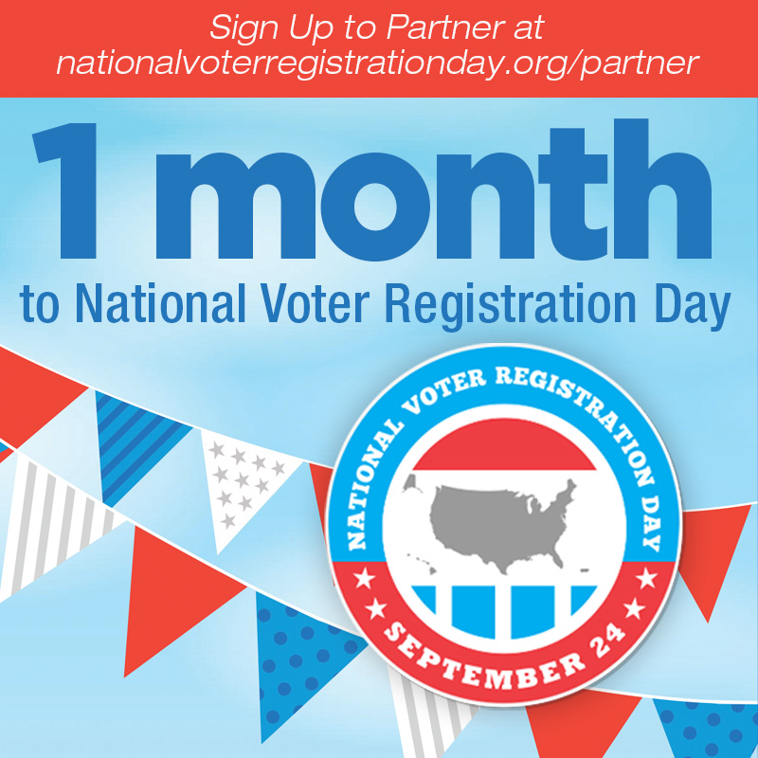
Best Practices for Promotion
Follow these tips to be an outreach superstar
On social media…
Use the right hashtags: #NationalVoterRegistrationDay and #VoteReady
Use @ replies to get our attention (and others!)
Be conversational in tone
Frequency works better for Twitter than Facebook

Slide 19
QUESTION & ANSWER
Use the chat box to send questions

Slide 20
Using the Event Tools

Slide 21
National Voter
Registration Day
THANK YOU!

